Slide 1
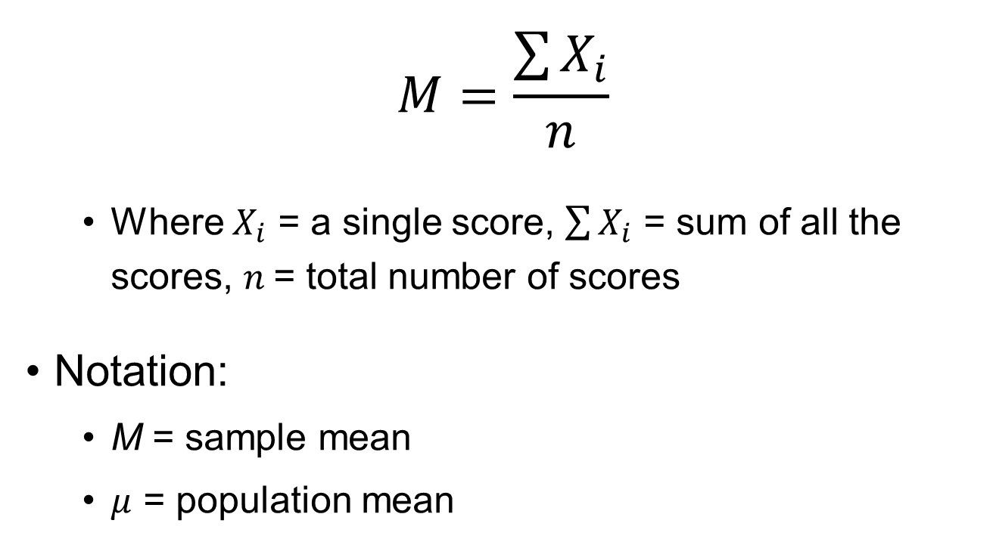
Mean
$$M=\frac{\sum{X_{i}}}{n}$$
Where $X_{i}$ = a single score, $\sum{X_{i}}$ = sum of all the scores, $n$= total number of scores
Notation:
M = sample mean
$μ$ = population mean

Slide 2

Median
Median location = $\frac{n+1}{2}$ = ___^{th} score
For an odd number of scores, the median is the middle score
For an even number of scores, the median is the average of the two middle scores

Slide 3
Mode
The mode is the most frequently occurring score in the distribution

Slide 4
Range
Range = highest score – lowest score

Slide 5
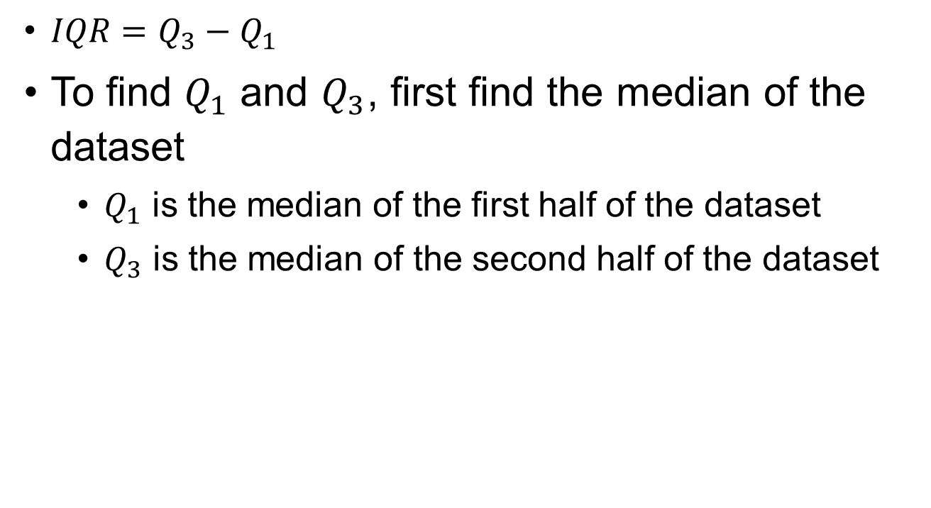
Interquartile Range (IQR)
$IQR=Q_{3}−Q_{1}$
To find $Q_{1}$ and $Q_{3}$, first find the median of the dataset
$Q_{1}$ is the median of the first half of the dataset
$Q_{3}$ is the median of the second half of the dataset

Slide 6

Outliers
The rule of thumb is that if the score is less than $Q_{1}−1.5(IQR)$ or greater than $Q_{3}+1.5(IQR)$, then we consider it to be an outlier

Slide 7
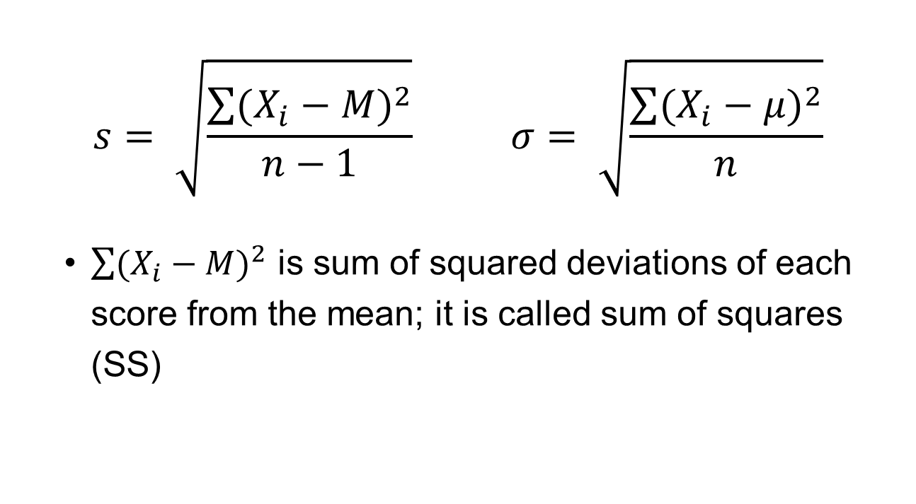
Standard Deviation
$$s= \sqrt{\frac{\sum{{(X_{i}−M)}^{2}}}{n−1}} σ= \sqrt{\frac{\sum{{(X_{i}−μ)}^{2}}}{n}}$$
$\sum{{(X_{i}−M)}^{2}}$ is sum of squared deviations of each score from the mean; it is called sum of squares (SS)

Slide 8
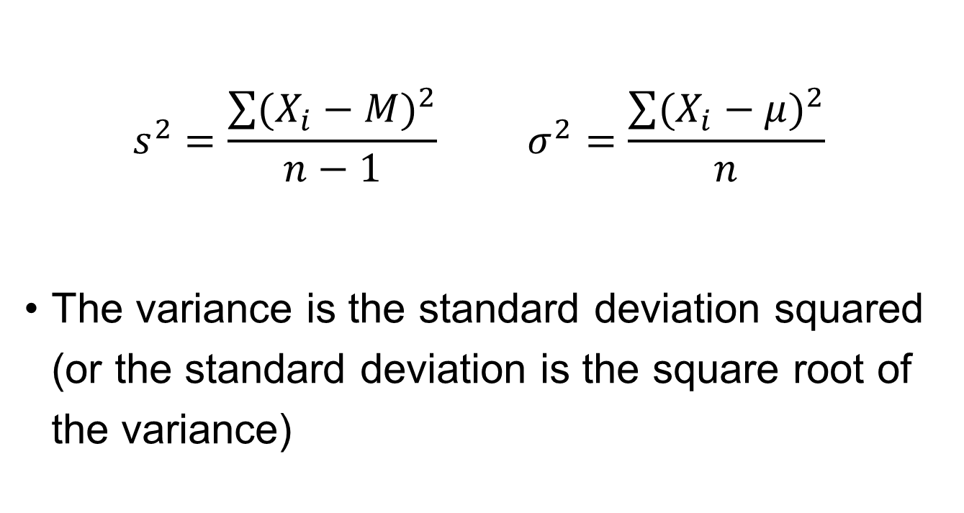
Variance
$$s^{2}=\frac{\sum{{(X_{i}−M)}^{2}}}{n−1} σ^{2}=\frac{\sum{{(X_{i}−μ)}^{2}}}{n}$$
The variance is the standard deviation squared (or the standard deviation is the square root of the variance)

